Slide 1

Comp9001: Nav U
Deliverable 1: The Pitch

Slide 2
Group & Roles
Group & Roles, Functionality, Utility & Interest
Members
Ted Kachulis
Parth Patel
Mike Stupich
Alexandre Skipper
Roles
Front End / User Interface
Back End / Map Generation
Design / Art
Information Management
Who’s working on NavU?

Slide 3

2. Functionality
Group & Roles, Functionality, Utility & Interest
Functional Properties
Maps: Store floor plans in some database
Directions: Step by step instructions
Search functionality: Quickly search
Schedule: Notifications & timing
Movement tracking:
Accelerometer, Gyroscope
What does NavU Do?
Non-Functional Properties
Performance: well optimized app
Storage
Usability: Good UI, On-screen map
Battery Consumption
Accessibility: Offline

Slide 4
3. Utility & Interest
Group & Roles, Functionality, Utility & Interest
Utility
Pathfinding through complicated buildings to help students get around
Interest
Why does this benefit us and other University students?
Uses and Why?

Slide 5
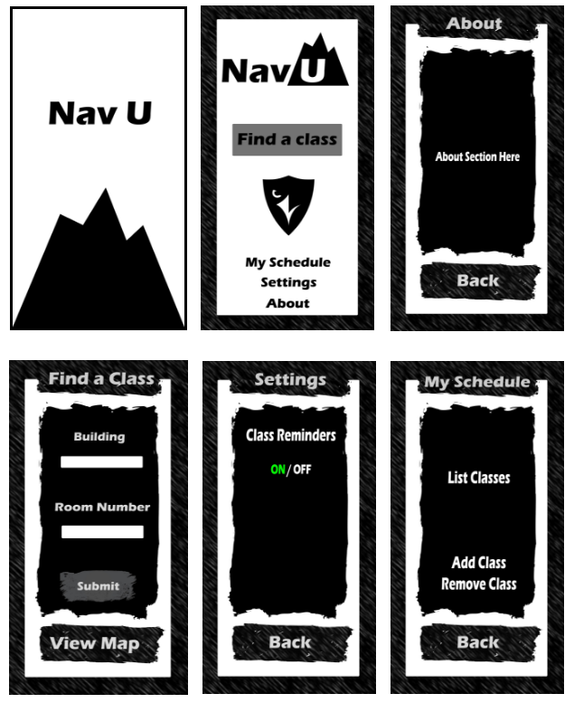
Sketches

